Slide 1
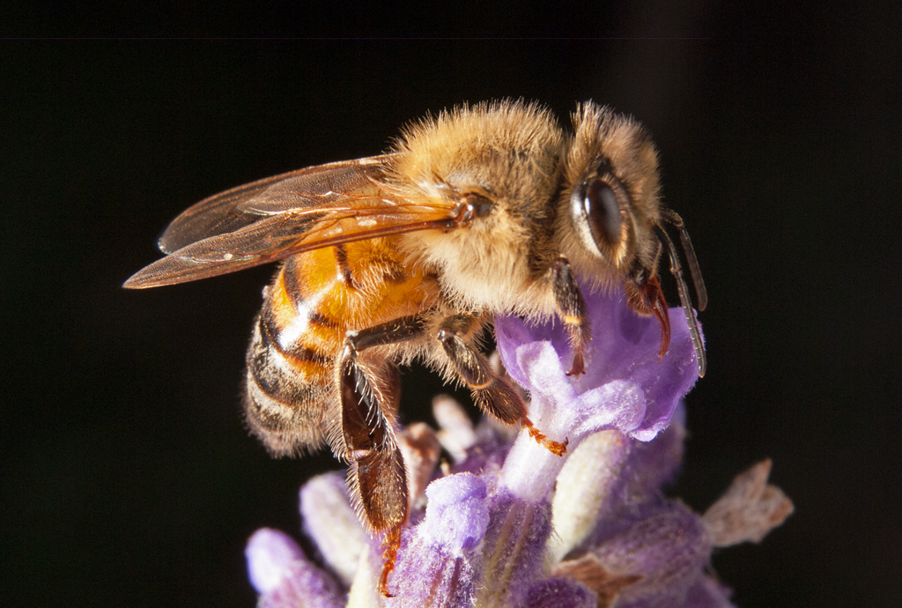
Beekeeping and Gardening to Protect Pollenators

Slide 2
You can find a copy of this presentation at my web site. LoneOakHoney.com on the Info and FAQ page.

Slide 3
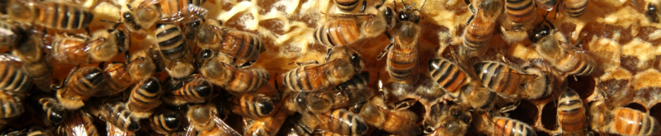
This talk is not for beginning beekeepers, it is for gardeners looking for ways to help our declining pollinators. If you are interested in a beginning beekeepers class the extension office may be offering one later this year. Contact Carol Larvick at clarvick1@unl.edu (402)987-2160.
I am a gardener and hobby beekeeper here in Sioux City. I have been a beekeeper for 7 years. I currently have 3 beehives and I have 4 more ordered for later this spring.

Slide 4
Declining pollinator populations
Most of you are probably aware that our pollinators, our honey bees, butterflies, bumblebees & solitary bees are in decline. This decline first started attracting media attention when honeybees started disappearing in large quantities back in 2006. Researchers call the mass disappearance Colony Collapse Disorder (CCD), & they estimate that nearly one-third of all honey bee colonies in the country have vanished. They have been looking for a cause for almost 10 years, but it is still unknown. It is becoming more and more evident that our honeybees and other pollinators are being stressed by many factors, many of which come from traditional beekeeping and traditional agriculture.

Slide 5
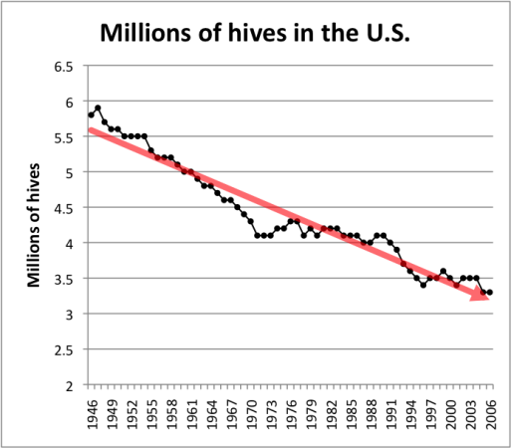
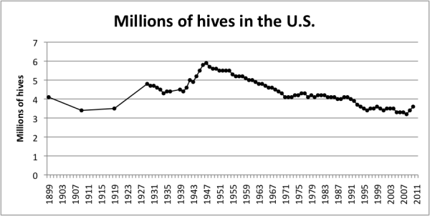
Declining pollinator populations
This chart probably puts things in a better perspective. It shows US hives peaked in about the 1950’s and that since CCD appeared in 2006 hives have actually increased a little. This increase is driven by the fact honey prices and pollination prices have increased and this caused beekeepers to try to increase their number of hives. What it does not show is how much more difficult it has become for beekeepers to continue to increase their number of hives.
Randy Oliver http://scientificbeekeeping.com/
Recently this has been a pretty common chart used to indicate the steep decline in honeybee colonies in the US. But it may be a bit tilted.
Randy Oliver http://scientificbeekeeping.com/

Slide 6
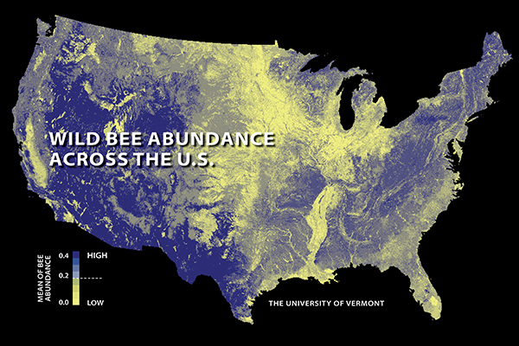
Wild Bee Populations
University of Vermont study
The first national study to map U.S. wild bees suggests they’re disappearing in many of the country’s most important farmlands — including California’s Central Valley, the Midwest’s corn belt and the Mississippi River valley.
The yellow areas of this map show where we have lower populations of wild bees.

Slide 7
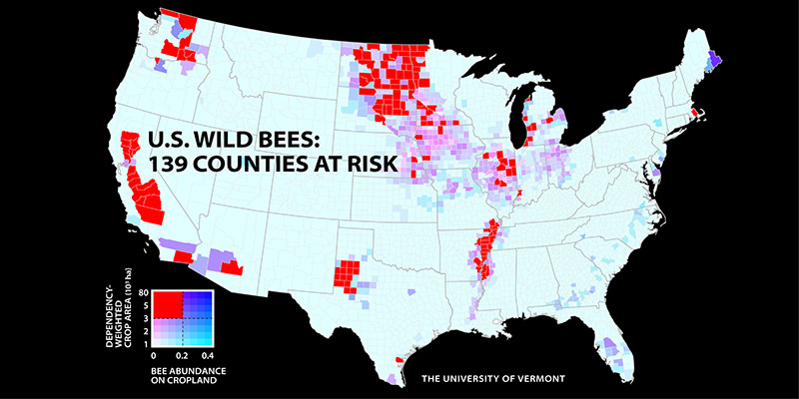
Wild Bee Populations
University of Vermont study
The research team estimates that wild bee abundance between 2008 and 2013 declined in 23 percent of the contiguous U.S.
The study also shows that 39 percent of U.S. croplands that depend on pollinators — from apple orchards to pumpkin patches — show a falling supply of wild bees & and increasing demand for pollination.

Slide 8
Wild Bee Populations
University of Vermont study
Of particular concern, the study shows that some of the crops most dependent on pollinators — including pumpkins, watermelons, pears, peaches, plums, apples and blueberries — have the strongest pollination mismatch, with a simultaneous drop in wild bee supply and increase in pollination demand.

Slide 9
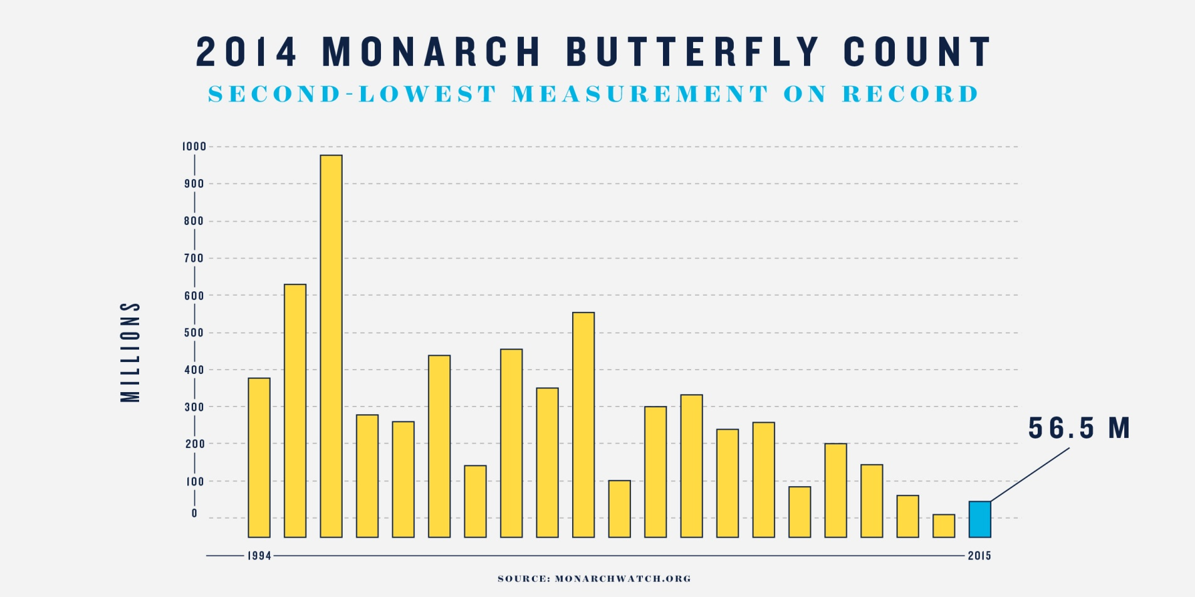
Monarch Butterfly Population Decline
The 2015 Monarch butterfly count is up from 2014. But at 56.5 million the population is still less than the total number of butterflies killed by extreme weather events we have experienced in the past.
This count is the second lowest on record.

Slide 10
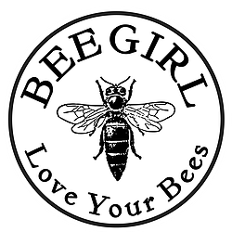
BeeGirl.org
If you get the chance watch This TED talk by Sarah Red-Laird from BeeGirl.org
https://www.youtube.com/watch?v=j92LBGHtGlY
What is killing the honeybees?

Slide 11
What Is Causing These Declines?
From www.beegirl.org What is killing the honeybees?
Varoa mites Chemical intensive and monoculture agriculture
Climate change Habitat loss

Slide 12
What Is Causing These Declines?
Habitat loss makes all the other factors that much harder for the bees to cope with. Since 2006 in just North Dakota, South Dakota and Nebraska we have lost 1.5 million acres of honeybee forage as prairies have been converted to corn and soybeans. Gone in less than 10 years.

Slide 13

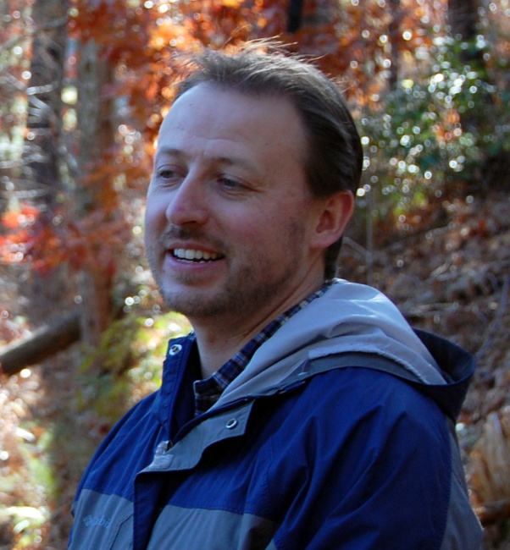
What Is Causing These Declines?
Jon Lundgren of Blue Dasher Farm www.BlueDasher.farm
I listened to Jon talk to a group of beekeepers on an American Beekeeping Federation webinar.

Slide 14
What Is Causing These Declines?
Lundgren said bee declines are not difficult to understand. “Yes, the bees are in crisis, and we need to help them. But what we have is not a bee problem. What we have is a biodiversity problem.”
Specifically a lack of diversity.
Perceptions of Biological Networks: “Our understanding of species networks primarily comes from simplified systems. But simplified systems ignore the complexity of biological communities and their unforeseen interactions.”

Slide 15
Perceptions of Biological Networks
Community Network in Agro-ecosystems
This chart from Blue Dasher Farm represents the insects found in one acre of corn field.
Each number represents one insect.
Each line connects one insect to every other insect that it has a population correlation with. When the population of one goes up or down the population of the other does also.
I feel this shows how things are interconnected in a way I have never seen before.

Slide 16
Perceptions of Biological Networks
Imagine how different this would look if we removed just one insect. Some correlate with so many others that the difference would be huge.

Slide 17
Why is this so important?
Approximately one third of all the food Americans eat is directly or indirectly derived from honey bee pollination.
Some crops, including blueberries and cherries, are 90-percent dependent on honeybee pollination;
one crop, almonds, depends entirely on the honey bee for pollination at bloom time.
Honey bees contribute over $14 billion to the value of U.S. crop production.

Slide 18
Why is this so important?
The bees have many things working against them and they had a though job to begin with.
On average, a worker bee in the summer lives six to eight weeks. Their most common cause of death is wearing their wings out.
During that six to eight-week period, their average honey production is 1/12 of a teaspoon.
In that short lifetime, they fly the equivalent of 1 &1/2 times the circumference of the earth (24,901 miles * 1.5 = 37,351 miles).
It takes over 750 bees to make one pound of honey.
The bees need to visit nearly 2 million flowers to fill a 1 pound jar of honey.

Slide 19
What Can Gerdeners Do to Help
? ? ?

Slide 20
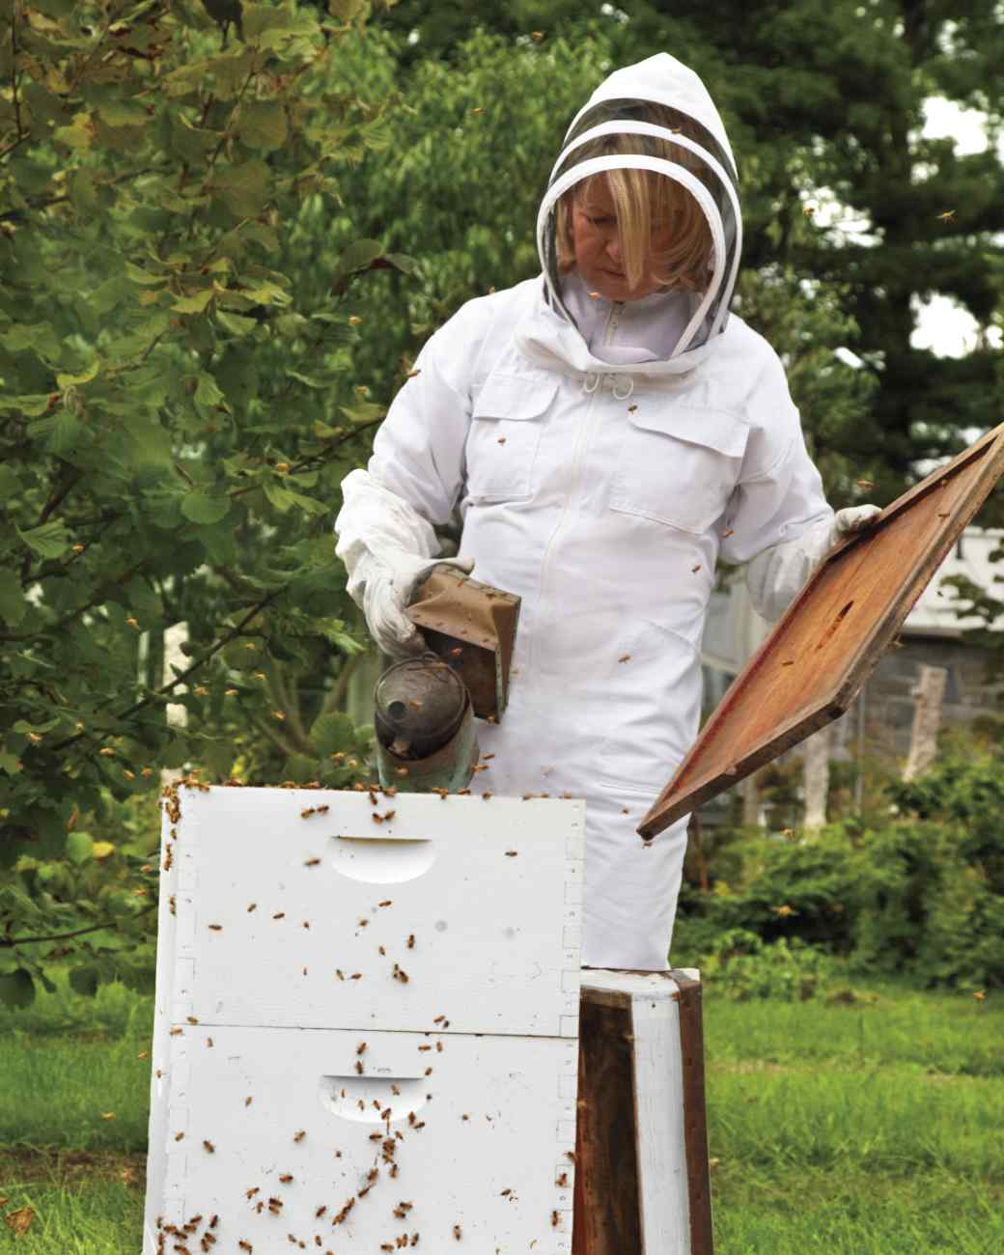
Become a Beekeeper!
Keeping bees can take as little or as much time as you like. Honeybees are very self-sufficient once have provided enough space for them to live in.
It is best to start with a beekeeping class.

Slide 21
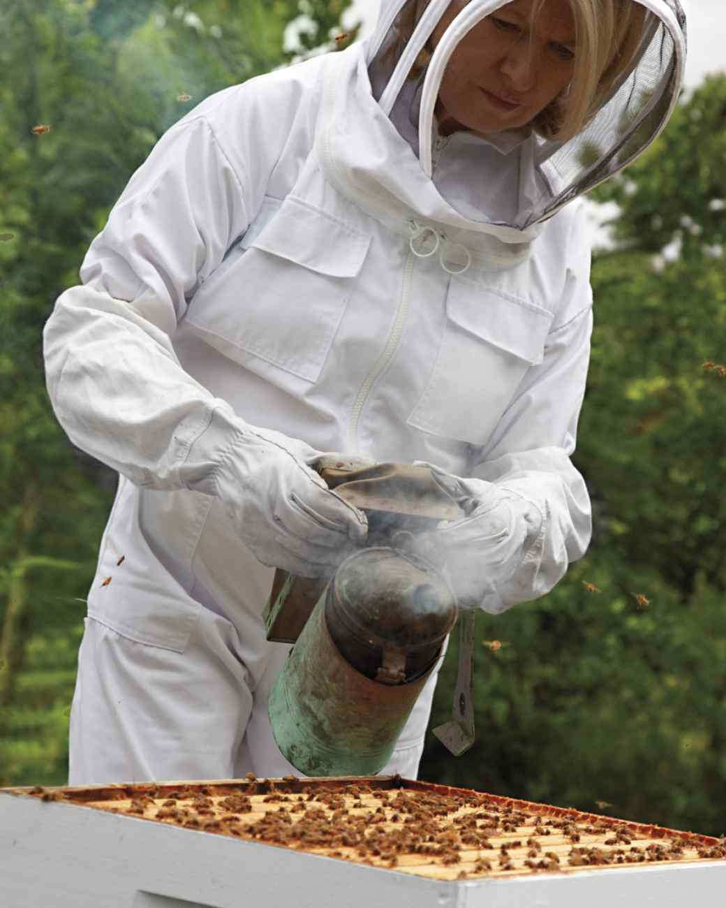
Become a Beekeeper!
If Martha Stewart can do it you can do it!
But you can not do it within Sioux City city limits. It is not legal to keep bees in Sioux City.

Slide 22
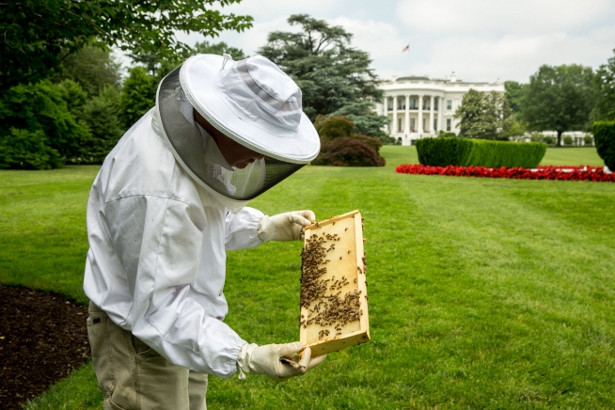
Become a Beekeeper!
There is even a beehive at the White House!

Slide 23
Build a Bumble Bee nesting box
There are plans online.
The University of Nebraska Extension has a good publication: Conserving Bumble Bees, Nebraska Extension publication EC1587
https://marketplace.unl.edu/extension/extpubs/entomology/ec1587.html

Slide 24
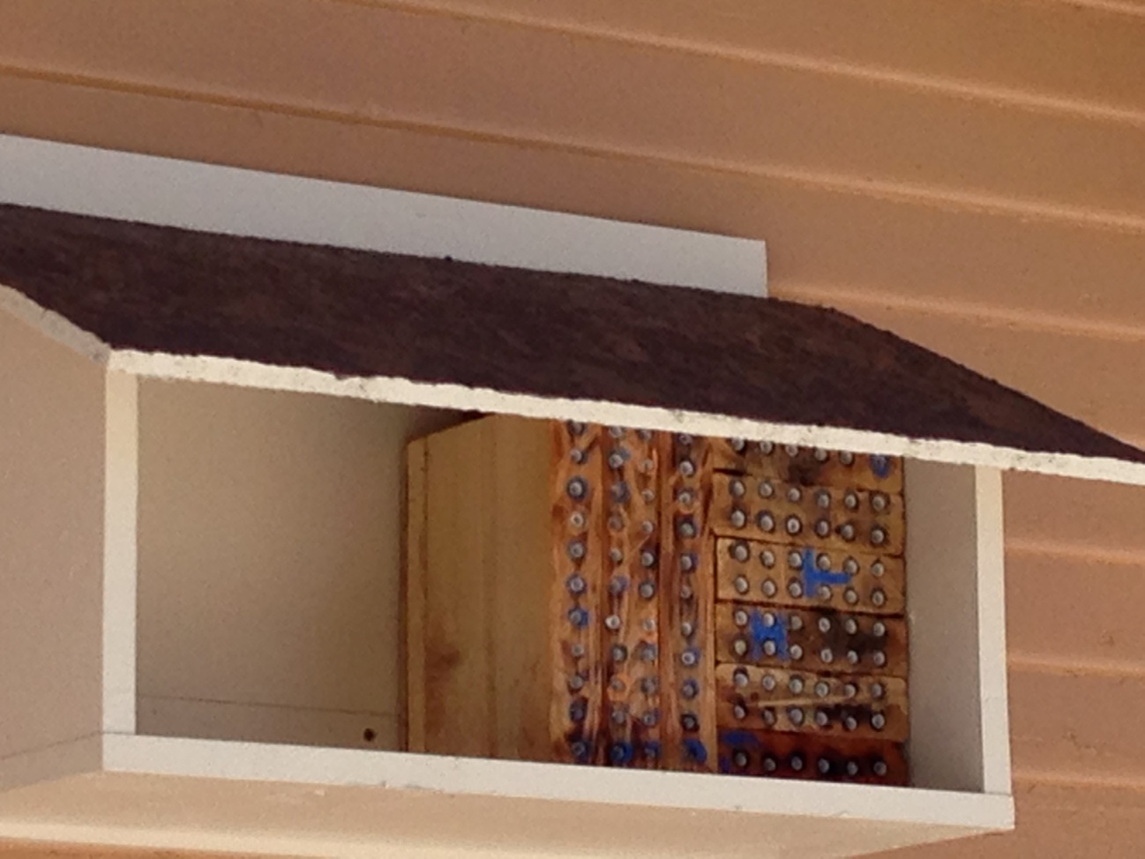
Build a Mason Bee & Leaf Cutter Bee house
There are plans online and on my website.
Mason bees and leaf cutter bees don’t make honey but they are more efficient pollinators than honeybees. Some estimated needs per acre are 1000-1500 bees, or ~300 nesting females for Blue
Orchard Mason bees compared to 2 – 3 honeybee hives per acre (50,000 or more bees per hive!)

Slide 25
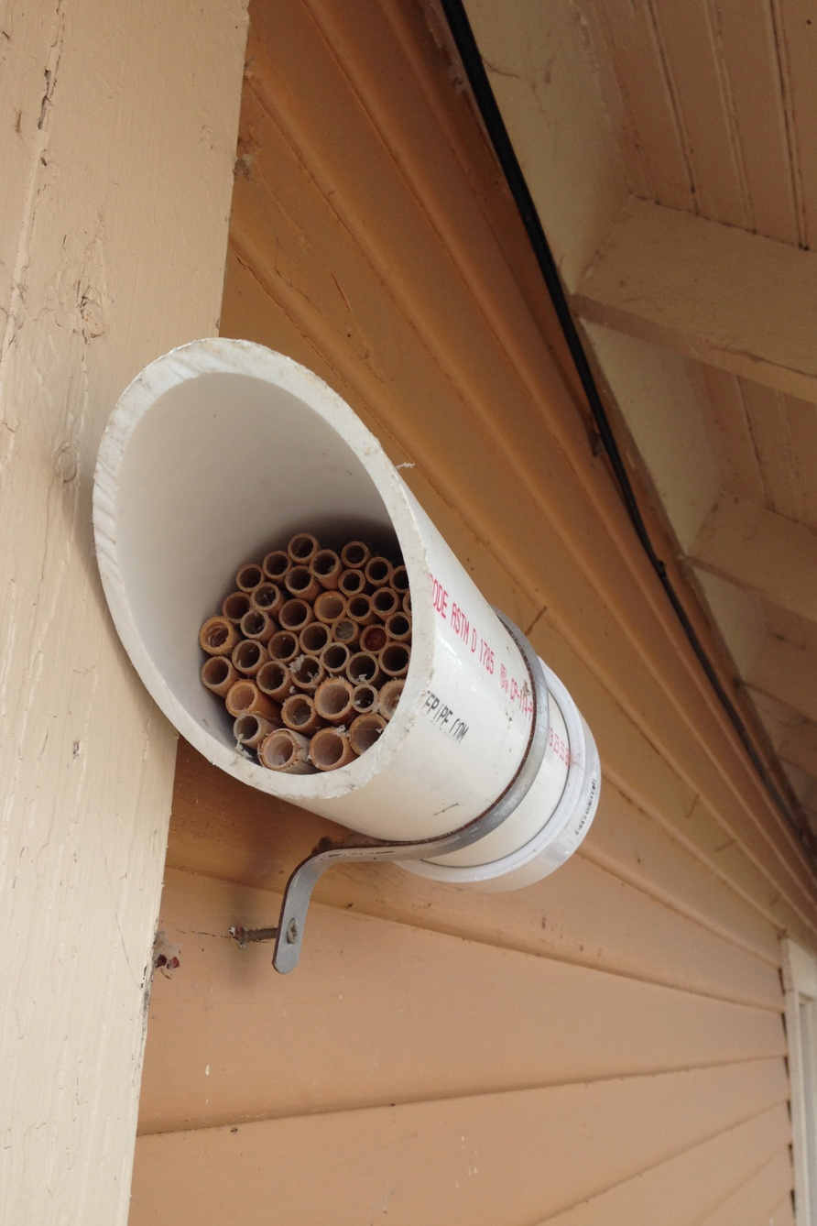
Build a Mason Bee & Leaf Cutter Bee house
Mason Bees and Leaf Cutter Bees are very good pollinators for gardens. They tend to stay within 300 feet of there nest site. For Mason Bees (early spring) you also need to give them access to mud close to the nest site.

Slide 26
Build a Mason Bee & Leaf Cutter Bee house
The female bee collects pollen and deposits it in the nesting tube.
When she has packed in enough pollen she tops it off with some nectar and lays an egg on the pile.
Then she seals the compartment with mud (or leaves).
Then she starts the process over in the next compartment.
She continues until the tube is filled to the end.
You can tell when the tube is full by the mud (or leaf) cap on the end
-From Managing Alternative Pollinators: A Handbook for Beekeepers, Growers, and Conservationists, SARE Handbook 11, by Eric Mader, Marla Spivak, and Elaine Evans, and copublished by SARE and NRAES

Slide 27
Lifecycle of a Mason Bee
From egg to larva
Cocoon by June
Pupa by July
Dormant adult from September to April
You can move them into an unheated garage in October
-From Managing Alternative Pollinators: A Handbook for Beekeepers, Growers, and Conservationists, SARE Handbook 11, by Eric Mader, Marla Spivak, and Elaine Evans, and copublished by SARE and NRAES

Slide 28
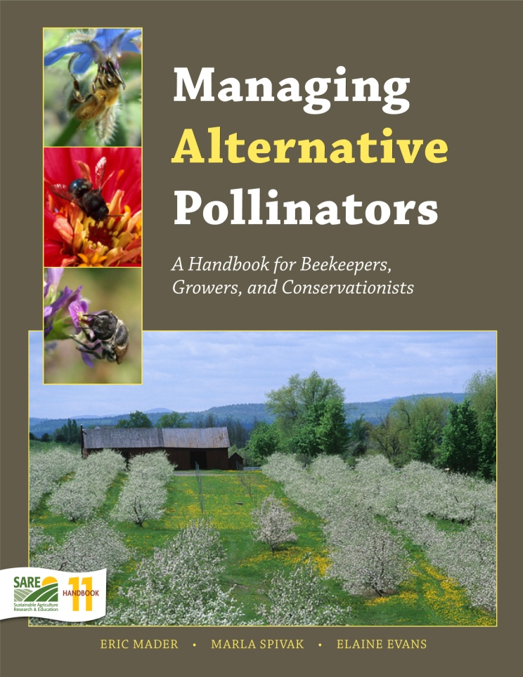
Build a Mason Bee & Leaf Cutter Bee house
This is a free PDF that is a really great source of information on Mason bees, Leaf Cutter bees and Bumble bees. If you only read one thing on alternative pollinators this should be it. There is more information here than you will find anywhere else. You can download it from:
http://www.sare.org/Learning-Center/Books/Managing-Alternative-Pollinators

Slide 29
My simple PVC bee nesting house

Slide 30
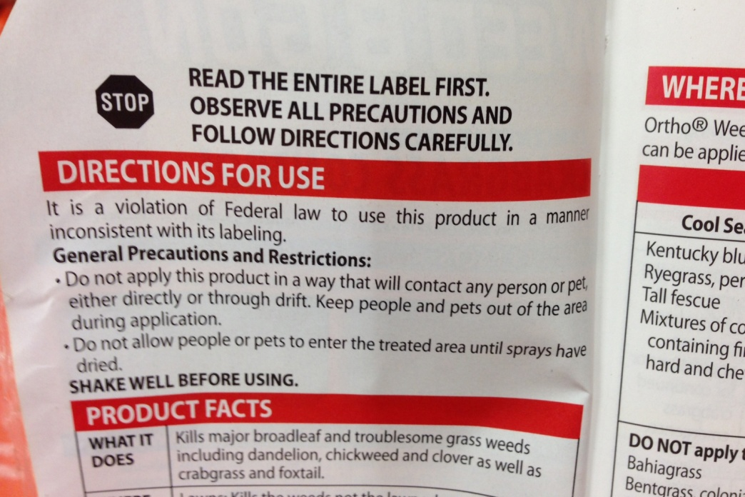
Pesticide, Herbicide and Fungicide use
Seriously consider if you need to spray. Not spraying is always safer.
Even if what you are spraying doesn’t kill pollinators directly it can have sublethal effects that are detrimental.
If you must spray read ALL of the label and follow the directions.
These are serious chemicals and you have a responsibility to handle them properly.

Slide 31
Pesticide, Herbicide and Fungicide use
Do not spray anything that is blooming!
Spray just before sunset or at night when pollinators are not active.
Spray when temperatures are lower and pollinators are less active.
Avoid spraying bee nesting areas or butterfly host plants.
Use the lowest recommended dose.

Slide 32
Pesticide, Herbicide and Fungicide use
AVOID DRIFT
Use the lowest pressure setting you can.
Even light winds can cause pesticide drift.
Spray when winds are calmer, usually morning or evening hours. Again just before sunset is better for the pollinators.
Even organic pesticides can harm pollinators. Pyrethrin, and spinosad, are both common in organic gardening and are broad-spectrum insect killers.

Slide 33
Mow your lawn within a week of spraying.
If you are using a white grub insecticide with imidacloprid, mow the lawn within a week of the application to minimize exposure to bees visiting clover.
Iowa State University Extension and Outreach “Protecting Bees From Pesticides”

Slide 34
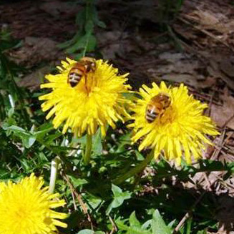
Pesticide, Herbicide and Fungicide use
Do you really need to spray all the dandelions?
Dandelions are one of the earliest sources of pollen and nectar.
For honeybees, dandelion pollen is just one amino acid from the perfect food.
Do you really need to spray all the clover in your lawn?
Dutch White Clover is an excellent nectar source.

Slide 35
Can Gardeners Save The Pollinators?
With so many of the problems pollinators face coming from habitat loss and lack of diversity who is in a better position to help than home gardeners are?
Farmers may control more land than gardeners do but that land needs to produce a profit and feed a nation.
You do not have those same restraints in your back yard. You can grow anything you want in your back yard.
If you want to take out all your grass and replace it with wildflowers you can.
If you want to stop spraying your yard and let all the dandelions and clover grow you can. (Really, just ask my neighbors!)

Slide 36
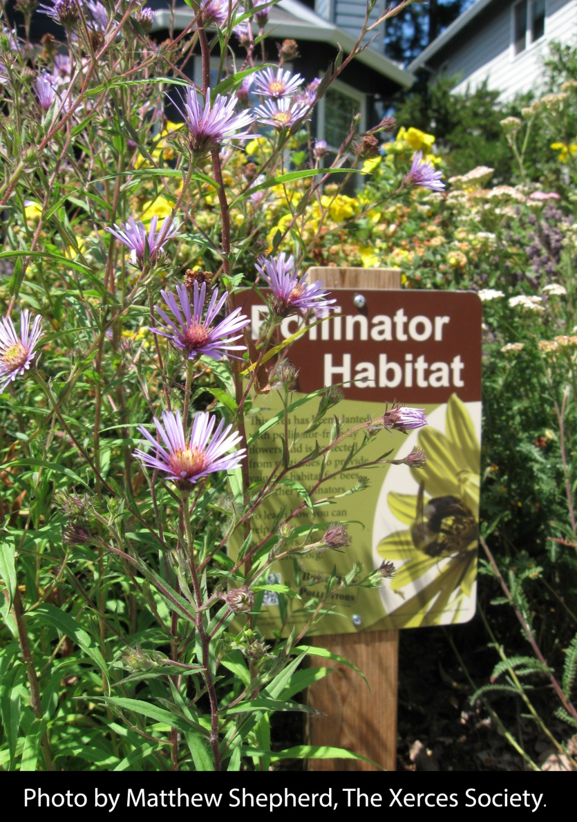
What Should you Plant?
Plant wildflowers. There are programs available you can participate in.
I have free wildflower seeds you can take home. They came from the Papio-Missouri River Natural Resources District (www.papionrd.org)
These are a Bee Friendly wildflower mix

Slide 37
Plant Wildflowers!
Who wouldn’t love to have this in their backyard?

Slide 38
Planting for honeybees
Honeybees make most of their honey during what we call the main nectar flow. Around here it starts in early to mid June. If we are lucky it last a little over two weeks.
At this time most of the nectar is coming from clover. White clover, yellow clover and the stuff in your lawn, Dutch White Clover.
If you do not have any clover around you definitely can plant some. The yellow and white clover get fairly tall (3 feet or more) so it will take some space.
There are a lot of plants that bloom at the same time as clover. So when the bees really need help is all the time outside of the middle of June.

Slide 39
Planting for honeybees
In the early spring you can let some dandelions grow.
If you do not have fruit trees you could plant some. Apple, cherry, peach, plum. Chokecherry and Aronia berry bloom a little later so that helps extend the spring bloom.
Most areas have some dandelions and a few fruit trees and therefore the spring is well covered. But there simply are not as many fall nectar producing plants so chances are most areas could use more plants that bloom in the fall.

Slide 40
Fall Planting for honeybees
Fall is the honeybees last chance to store enough honey to make it through the winter. Around here fall is when there is the least variety of plants producing nectar. So fall plants are where you can help the most.

Slide 41
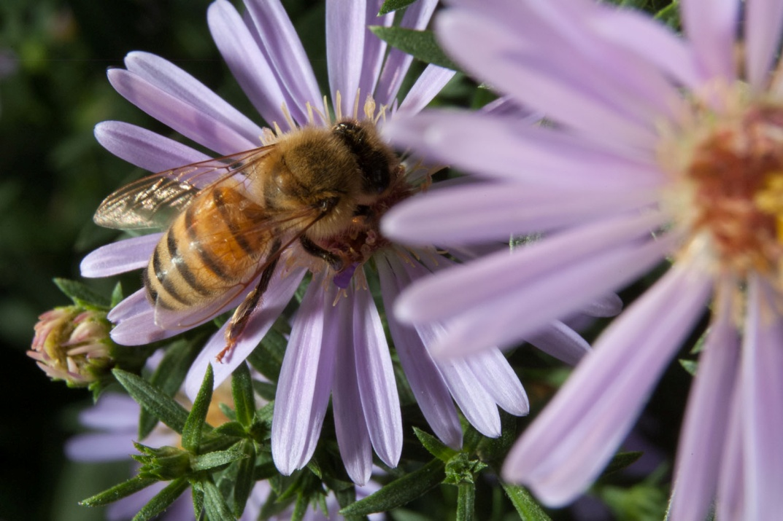
Fall Planting for honeybees
New England aster.
Prefers full to partial sun. Zone 4 to 8. Requires well drained soil.
large and showy, growing to 6 or more feet. (mine are only 3ft)
Common Sunflower. Or any sunflower you like, there are many to chose from. Grows anywhere.

Slide 42
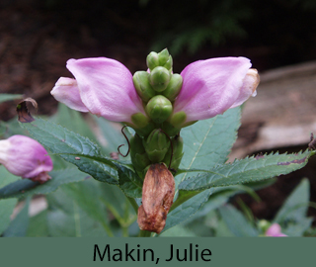
Fall Planting for honeybees
Turtlehead
(chelone oblique)
Figwort Family
Partial Shade. Moist soil.
Zone: 3 to 9
Height: 2 to 3 feet
Spread: 1 to 2 feet
Bloom Time: July to August

Slide 43
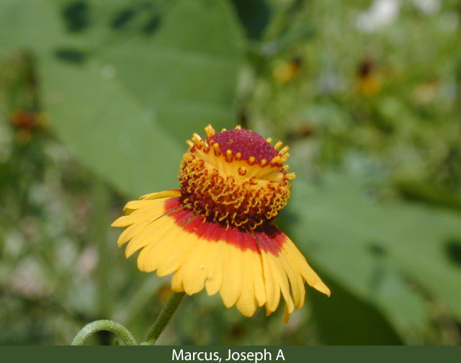
Fall Planting for honeybees
Sneezeweed
(Helenium quadridentatum Labill)
Aster Family
Prefers full to partial sun and wet to wet-medium soils.
May get 3 to 5 feet tall.
Despite its common name, it presents no problems for most allergy sufferers.

Slide 44
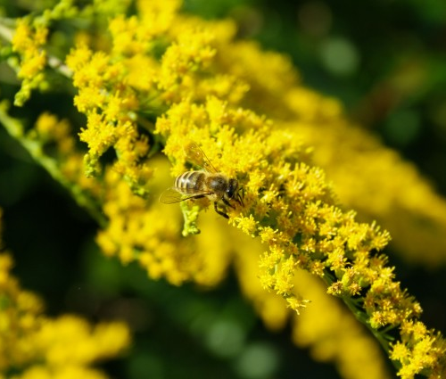
Goldenrod
Solidago altissima L.
Tall Goldenrod
Late Goldenrod
Canadian Goldenrod
Canada Goldenrod
(Aster Family)

Slide 45
Garlic Chives
Allium tuberosum
garlic chives
oriental garlic
Asian chives
Chinese chives
Chinese leek

Slide 46
Planting for other pollinators
The Mason bees and Leafcutter bees will also benefit from the plants I listed for honey bees.
The next thing you can do to help pollinators is plant host plants for the butterfly caterpillars.

Slide 47
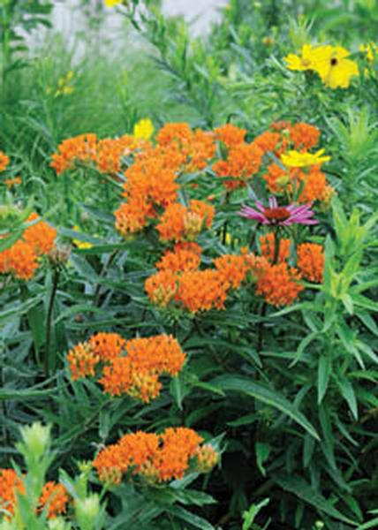
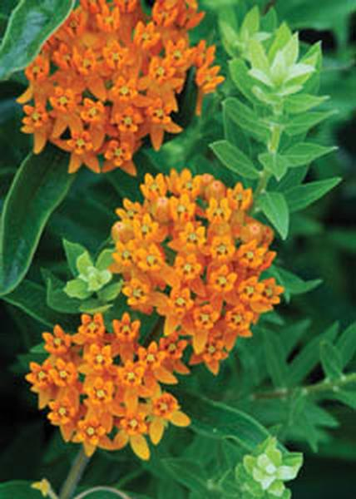
Grow Milkweed for the Monarch Butterflies
Milkweed is one of the only sources of food for the Monarch butterfly caterpillar.
You can let a few grow in your flowerbeds and keep them under control by removing the seed pods after they bloom.
There is a Butterfly Milkweed plant you can grow that is not considered a weed. Jon at Earl May tells me they will have it this year and he has had a lot of people asking for it.
www.earlmay.com/tips__solutions/plant__nursery_library/milkweed_butterfly/

Slide 48
Grow Milkweed for the Monarch Butterflies
“Scientist agree that the leading factor in the decline of monarch butterflies is the loss of milkweed, a native wildflower that the caterpillars depend on as their only food source. With the adoption of genetically modified crops that are resistant to the application of the herbicide glyphosate (also known as Roundup) milkweed that was once found in agricultural fields has been largely eliminated from the agricultural Midwest. And without sufficient amounts of milkweed the monarch population has declined.” http://switchboard.nrdc.org/blogs/sfallon/monarch_butterflies_cant_wait_.html

Slide 49
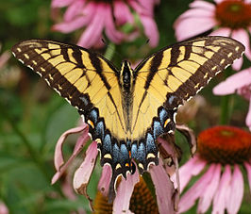
Eastern Swallowtail
The eastern black swallowtail's main host plant is wild Queen Anne's lace, but they also eat garden plants in the carrot family, including carrots, parsley, dill, and fennel.

Slide 50
Birds and Blooms
“Top Ten Butterfly Host Plants”
Passionflower (Passiflora), Zones 5 to 9. Gulf fritillary and the variegated fritillary.
Hollyhock (Alcea rosea), Zones 2 to 10. Painted lady caterpillars.
Willow (Salix), Zones 2 to 9. Viceroy, western tiger swallowtail and mourning cloak.
Dill (Anethum graveolens), annual. Black swallowtails
Chokecherry (Prunus virginiana), Zones 2 to 6. Two-tailed swallowtail
Snapdragon (Antirrhinum majus), annual. Common buckeye
Violet (Viola), Zones 3 to 10. Great spangled fritillary, as well as western fritillaries like Mormon, callippe and zerene.
Oak (Quercus), Zones 3 to 10. Horace’s duskywing and banded hairstreak
Everlasting (Anaphalis margaritacea), Zones 3 to 8. American lady butterflies
Switchgrass (Panicum virgatum), Zones 4 to 9. Skipper caterpillars need grasses like switchgrass
www.birdsandblooms.com/gardening/attracting-butterflies/top-10-butterfly-host-plants/

Slide 51
Thank You!

